Slide 1
Evaluating the effectiveness of non-contact pressure monitoring via multispectral imaging using Kubelka-Munk approach

Slide 2
Outline
Introduction
CTS
Normalization
ROI
Table
Summary

Slide 3
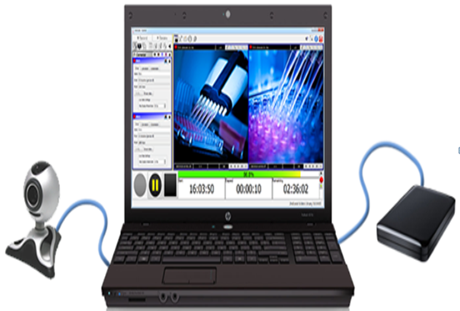
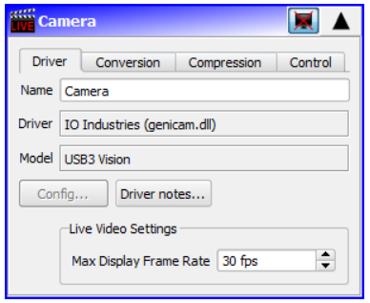
Introduction
2ndlook software
Video recording software

Slide 4
Cont…
Multi Spectral Imaging
Captures image data within specific wavelength ranges
Revealing details beyond human vision
Biomedical Multispectral Imaging System
Have 4 bands suitable for detecting hemoglobin and lipid
735, 800, 865, and 930 nm
Used for a number of analysis
oxygen saturation and total hemoglobin
Important for monitoring tissue health

Slide 5
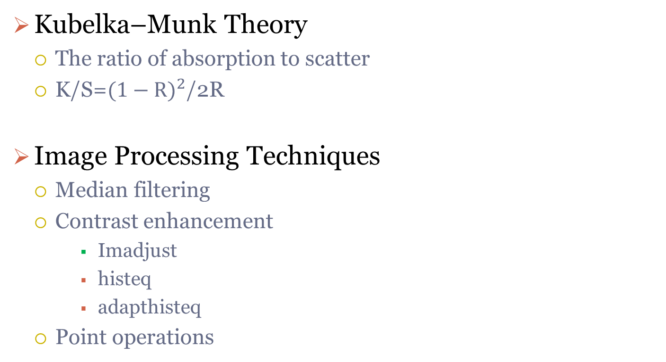
Cont…
Kubelka–Munk Theory
The ratio of absorption to scatter
K/S=${(1−R)}^{2}$/2R
Image Processing Techniques
Median filtering
Contrast enhancement
Imadjust
histeq
adapthisteq
Point operations

Slide 6
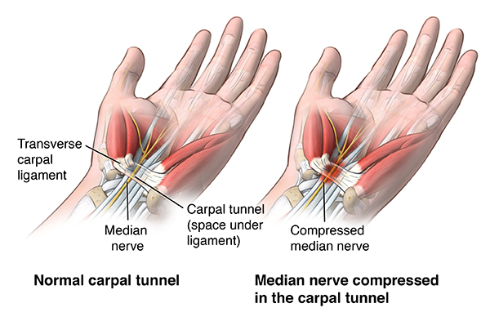
Carpal Tunnel Syndrome (CTS)
Caused by pressure on the median nerve
Carpal tunnel is a narrow passageway formed by bones and ligaments

Slide 7
Parameters
Standard Normal Variate (SNV): (Img-mean)/std
Kurtosis: A measure of whether the data are heavy-tailed or light-tailed relative to a normal distribution
Skewness: Measure of symmetry
Energy: Refers to the amount of information or the "smoothness" of the image
Entropy: Measures the amount of uncertainty or randomness in an image
Power Spectral Density (PSD)
Resolution: width per pixel
FDR: Fisher Discriminant ration

Slide 8
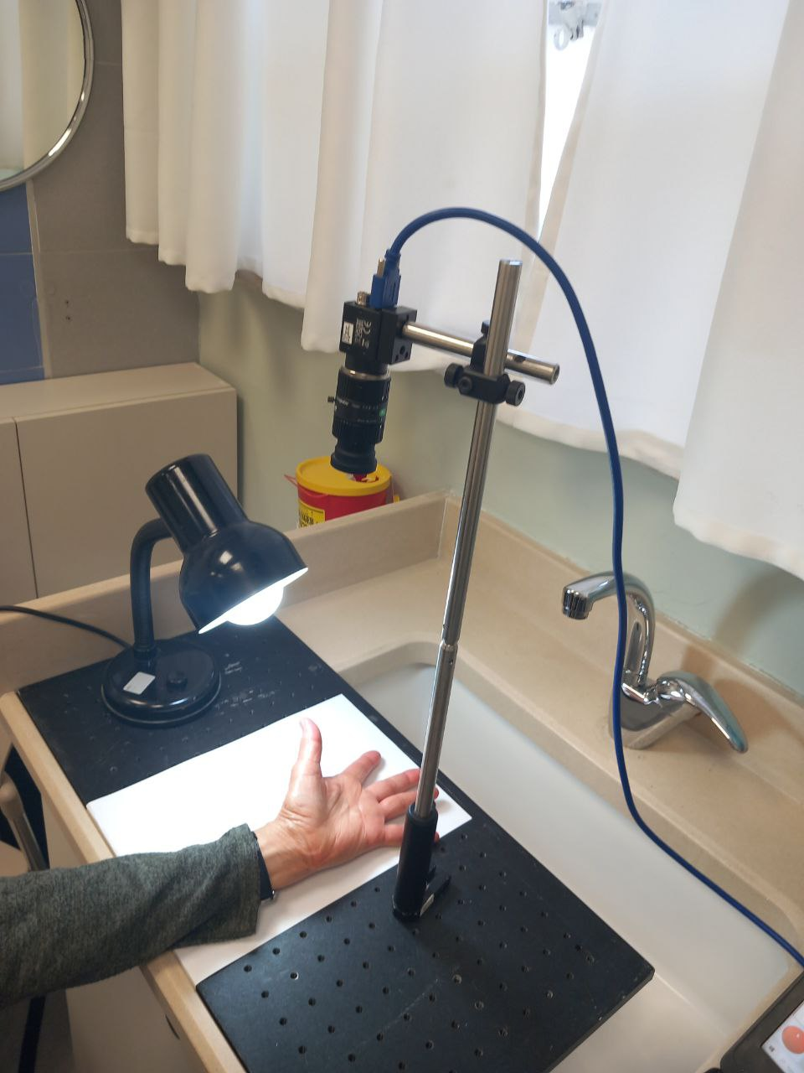
Patient Details(Subject#9)
Age:76
Gender:Female
Left: Pressure
Right: Normal
Resolution:0.012 cm/px
Exp date: 12/03/25

Slide 9
Image Processing Techniques
Imadjust function for contrast enhancement
Median Filter
Imlocalbrighten and
Some point operations

Slide 10
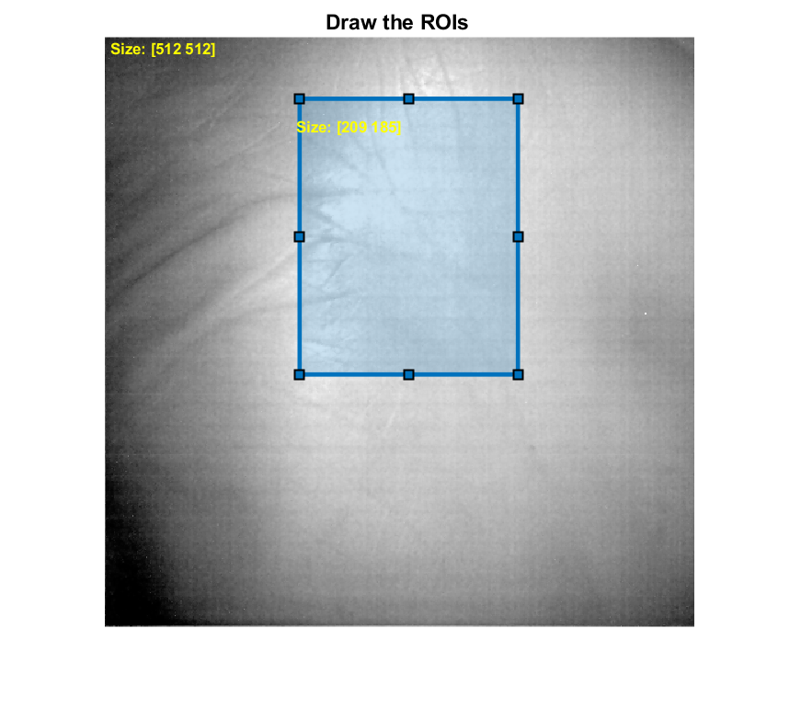
Normalization (ROI)

Slide 11
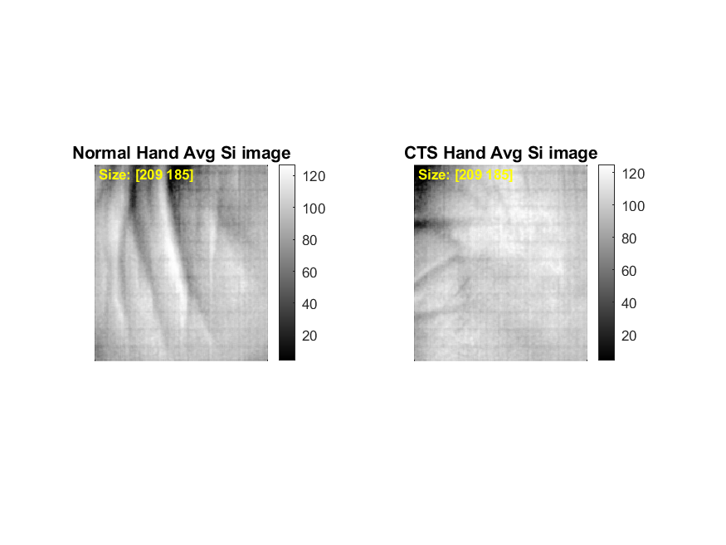
Average (n=26) Si Images @930 nm

Slide 12
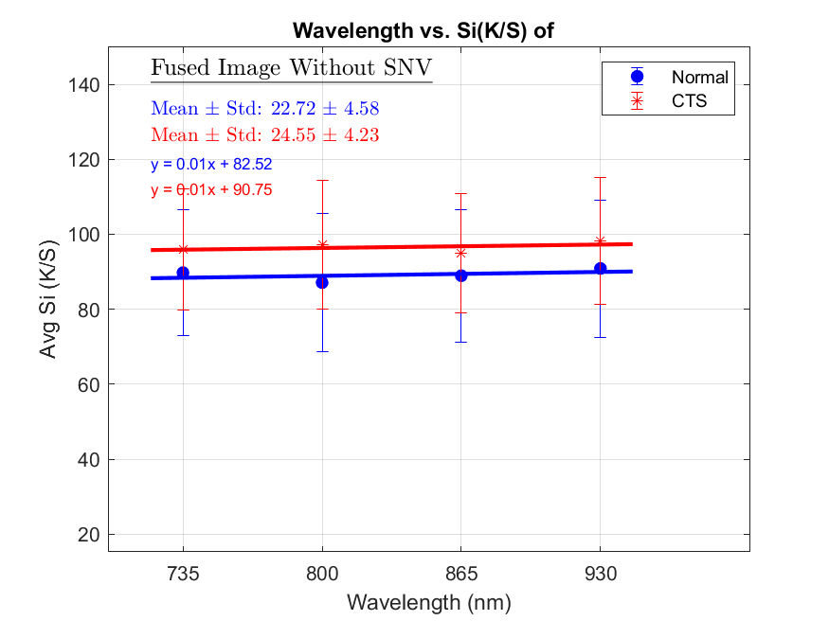
Avg Si of 26 images
Fused Image without SNV 47.44±4.23|58.93±5.69

Slide 13
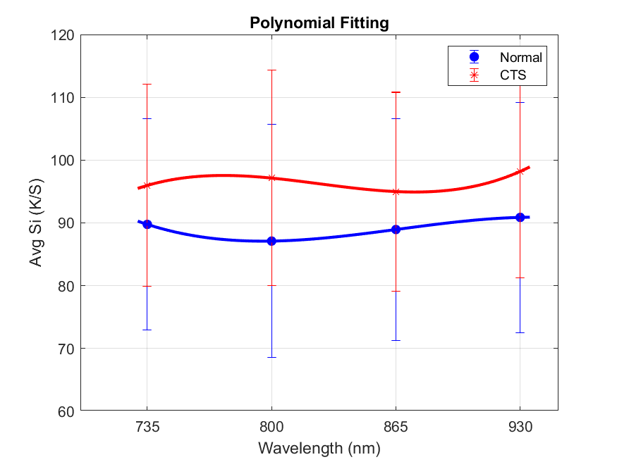
Avg SI Vs. wavelength

Slide 14
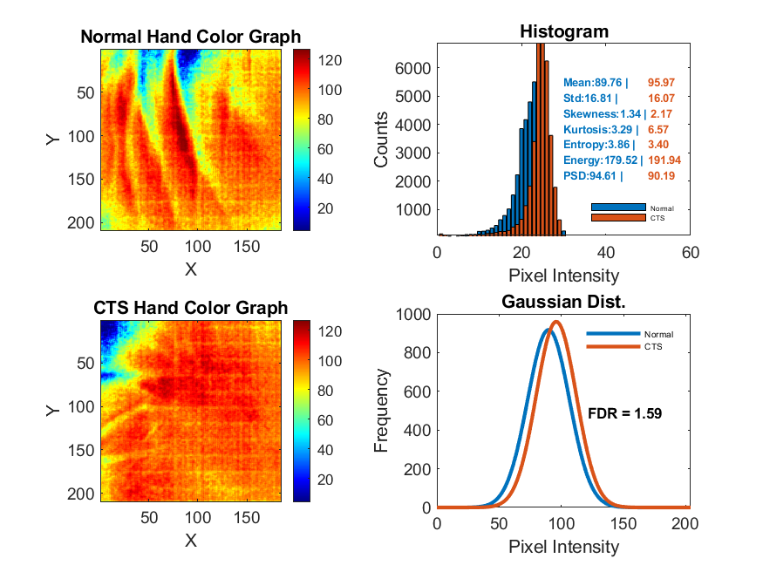
Normal Vs. CTS hand (735 nm)

Slide 15
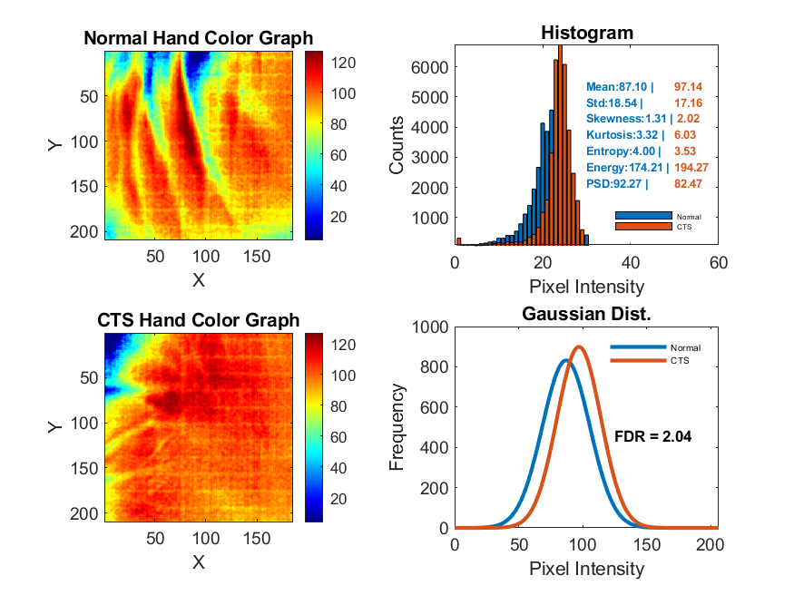
Normal Vs. CTS hand (800 nm)

Slide 16
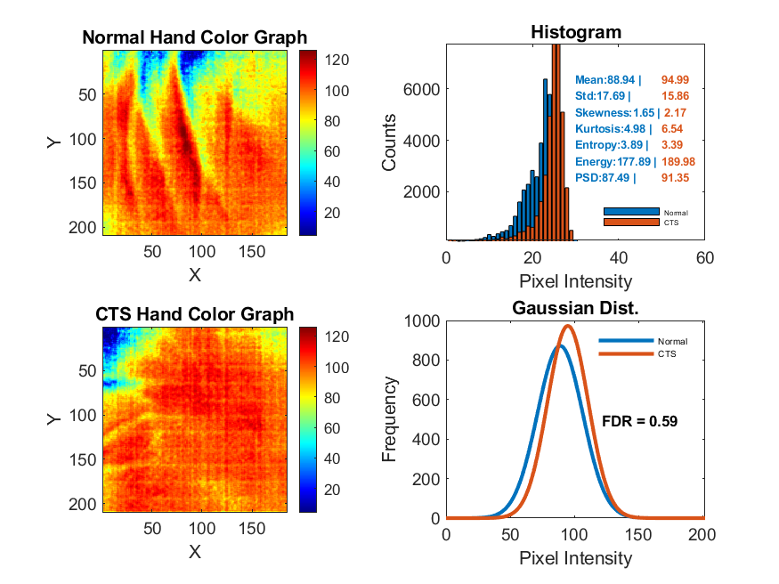
Normal Vs. CTS hand (865 nm)

Slide 17
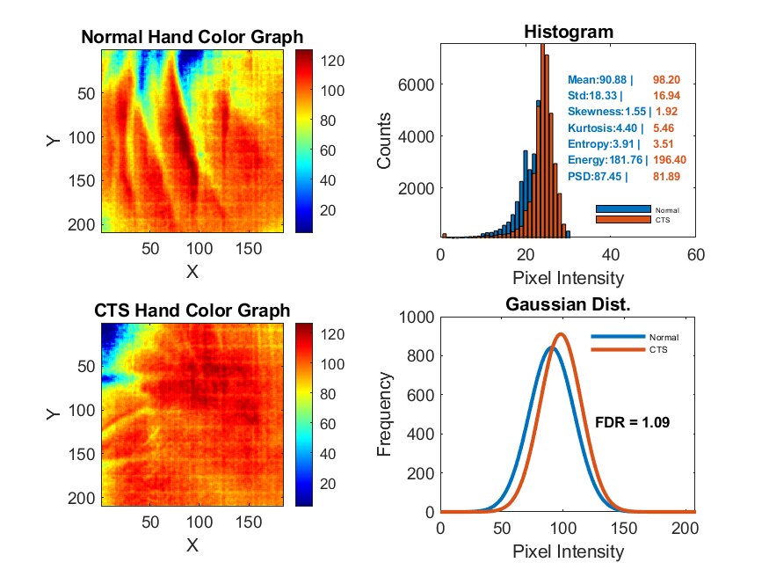
Normal Vs. CTS hand (930 nm)

Slide 18
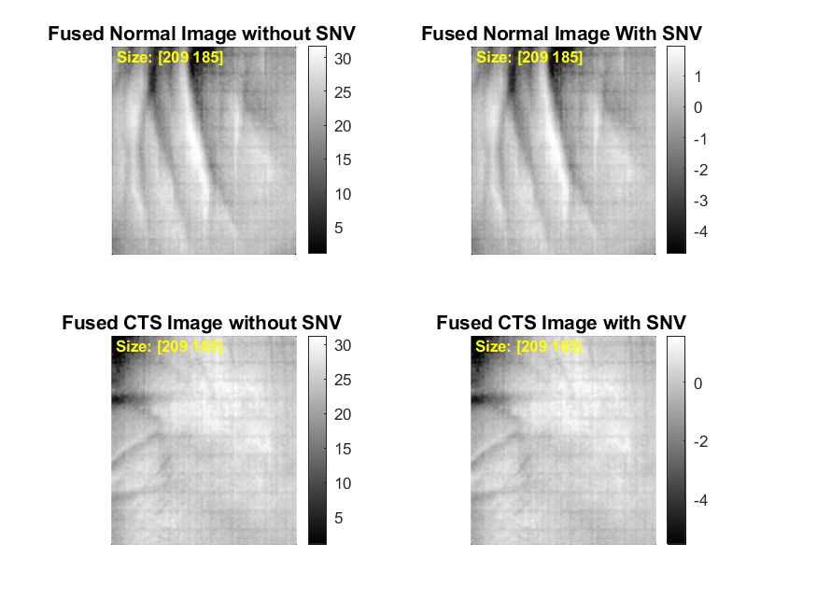
Fused Images
It is average image of all wavelength

Slide 19
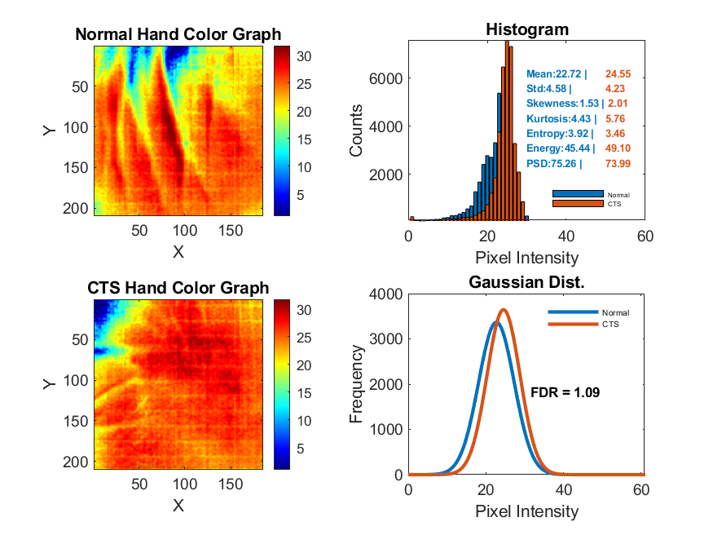
Fused Normal Vs. CTS Images (Without SNV)

Slide 20
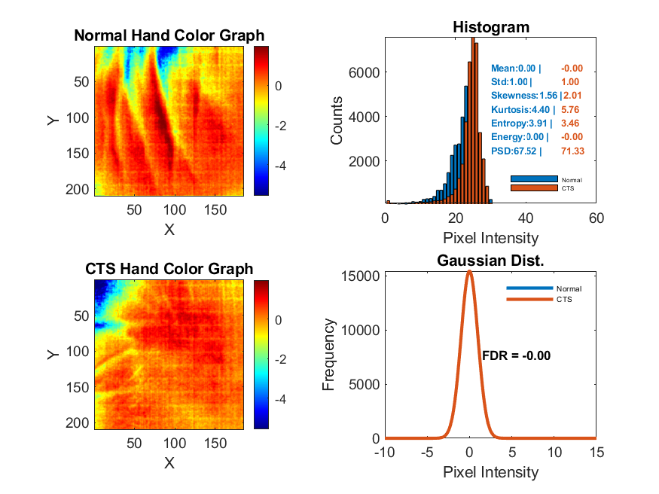
Fused Normal Vs. CTS Images (With SNV)

Slide 21
Relative Difference (threshold above 10%)
wavelength | 735 nm |  |  | 800 nm |  |  | 865 nm |  |  | 930 nm |  |  | Fused (Without SNV) |  |  | Fused (With SNV)
Params | Normal | CTS | Change(%) | Normal | CTS | Change(%) | Normal | CTS | Change(%) | Normal | CTS | Change(%) | Normal | CTS | Change(%) | Normal | CTS | Change(%)
Mean | 89.76 | 95.97 | 6.91 | 87.1 | 97.14 | 11.52 | 88.94 | 94.99 | 6.8 | 90.88 | 98.2 | 8.05 | 22.72 | 24.55 | 8.05 | 0 | 0 | 0
Std | 16.81 | 16.07 | 4.38 | 18.54 | 17.16 | 7.47 | 17.69 | 15.86 | 10.37 | 18.33 | 16.94 | 7.61 | 4.58 | 4.23 | 7.61 | 1 | 1 | 0
Skewness | 1.34 | 2.17 | 62.27 | 1.31 | 2.02 | 53.97 | 1.65 | 2.17 | 31.04 | 1.55 | 1.92 | 23.86 | 1.53 | 2.01 | 31.26 | 1.56 | 2.01 | 29.48
Kurtosis | 3.29 | 6.58 | 99.7 | 3.32 | 6.03 | 81.57 | 4.98 | 6.54 | 31.33 | 4.4 | 5.46 | 24.03 | 4.43 | 5.76 | 30.12 | 4.4 | 5.76 | 30.83
Entropy | 3.86 | 3.4 | 11.98 | 4 | 3.53 | 11.78 | 3.89 | 3.39 | 13.05 | 3.91 | 3.51 | 10.42 | 3.92 | 3.46 | 11.61 | 3.91 | 3.46 | 11.4
Energy | 179.52 | 191.94 | 6.91 | 174.21 | 194.27 | 11.52 | 177.89 | 189.98 | 6.8 | 181.76 | 196.4 | 8.05 | 45.44 | 49.1 | 8.05 | 0 | 0 | 0
PSD | 94.61 | 90.19 | 4.67 | 92.27 | 82.47 | 10.62 | 87.49 | 91.35 | 4.41 | 87.45 | 81.89 | 6.35 | 75.26 | 73.99 | 1.69 | 67.52 | 71.33 | 5.63
FDR |  |  | 1.59 |  |  | 2.04 |  |  | 0.59 |  |  | 1.09 |  |  | 1.09 |  |  | 0.00

Slide 22
Summary(#9)
Kurtosis
Very high at 735 nm (99.7%) and 800 nm (81.57%)
Skewness
Peaks at 735 nm (62.27%), 800 nm (53.97%)
Entropy
Highest at 800 nm (11.78%), also relevant at 735 nm (11.94%) and 930 nm (10.42%)
Std
Elevated at 800 nm (7.47%), 865 nm (10.37%), and 930 nm (7.61%)

Slide 23
FDR in all CTS
735 nm | 800 nm | 865 nm | 930 nm | Remarks
2 | 4 | 3 | 3 | No Img Proc.
3 | 5 | 0 | 5 | Img Proc.
5 | 9 | 3 | 8 | Total

Slide 24
Thank you !

